Slide 1




Employment Trends: Desirable Applicant Skills of Physics Degree Holders
Sylphrena Kleinsasser, APS Careers Intern
1
Notes:
Hello everyone, I think I know everyone here, but just in case-I’m Sylphrena, a junior majoring in Physics and Chemistry at Lycoming College, with a minor in Computer Science. I am the Careers Intern this summer at APS. In this presentation, I will talk about Trends in Desirable Applicant Skills of Physics Degree Holders.

Slide 2

Internship Goals
Perform a quantitative analysis of keywords common to job descriptions
Create and catalogue a database of job postings from the APS Job Board
Examine correlations between skills and factors such as employment sector and job permanence
2
Notes:
My project goal was to use APS job board data to analyze skills of physics degree holders that are high in demand by employers. I needed to
create and catalog a database containing the data,
quantitatively analyze this data,
and examine correlations in the data based on sector and job permeance.

Slide 3

Project
Approach
Existing Tools Could Analyze Our Data
A Custom Solution is Better
Identifing job sector and job permanance with Excel
Preprocessing Improvements
3
Notes:
Various tools exist to catalog and analyze data. However, we needed a program to identify and count important keywords in our data based on specific conditions we specify. This is possible in tools such as excel, but such solutions are slow and difficult to implement. Rather, we chose to build our own program to achieve our goals.
Some classifications, such as job permanence, are not even given by the job board. This means that we need to make those classifications as a prior step in order to analyze our data based on those conditions. We used excel formulas to achieve this, but we hope to build this pre-processing into our custom solution in the future.

Slide 4
Functional Goals
Search Module
Search Conditions
Find common keywords in the job descriptions to analyze
Define a list of conditions of interest – such as job sector – and find a way to classify them
Program Requirements
Analyze Module
Import data and keywords from spreadsheets and tie the program together with a GUI
Given a list of keywords, search our job postings count results by condition
4

Slide 5
Technical Choices
Python
SQLite3
Pandas
Simple, high level language that acts as a base for the program
Fast, locally stored database system to store and query job data
Efficient data processing module to import and export job data
5
Notes:
We chose to build our program in python, with various modules to handle user interfaces, our database system, and data conversions.
Specific choices include SQLite3, a fast and locally operated python module, as our database system.
I also implemented pandas, numpy, and other modules to handle file conversions. The final product is a fully contained executable program that can quickly and efficiently process our data and spit out results.

Slide 6
How it works:
Python and Pandas can count job keywords in the search module
mySQL queries can quickly count data based on condition and send results to the analyze module
Pandas parses data for import or export from csv spreadsheets
pySimpleGUI interfaces with the user to accept input and handle error checking
6

Slide 7
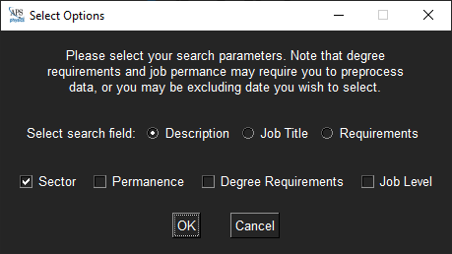
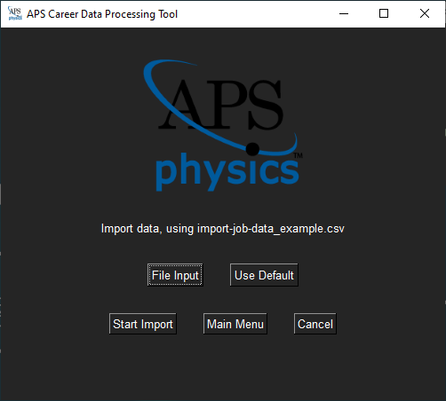
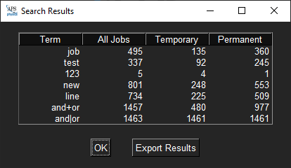
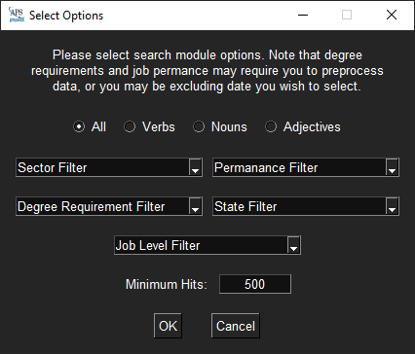
Data Processing GUI
Results
Find Keywords
Analyze Data
Import Menu
7
Notes:
First, the program creates and populates the job database with the import menu.
Then, the we can use the search module to find the most common keywords in the job descriptions, with filters based on word type, minimum hits, and other filters. The program can send this data or custom keywords populated by the user to the analyze menu.
Here, we can select which field to analyze (job description, title, or requirements) and select which analyses to perform.
This module spits out our results, we can then export and analyze.

Slide 8
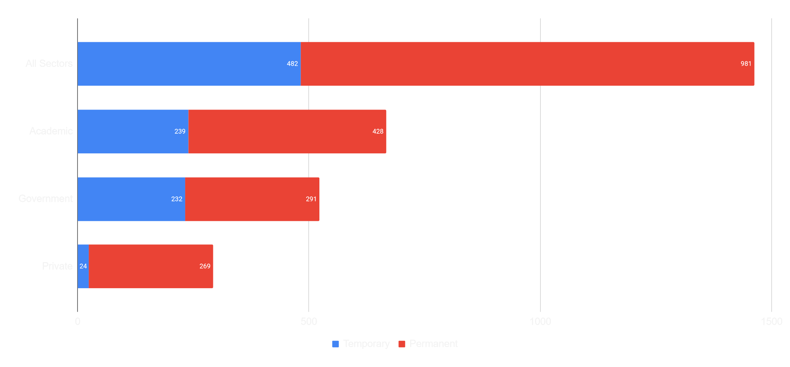
RESULTS
Job permanence by sector for all APS Job Board Postings since 2018 (1463 jobs)
8
Notes:
Before we delve into results by keywords, it would be a good idea to draw your attention to the trend in job permanence by sector. You may note that temporary jobs are much more common in academic and government sectors, as postdocs are much more common in those fields. Furthermore, private jobs are almost always permanent.

Slide 9
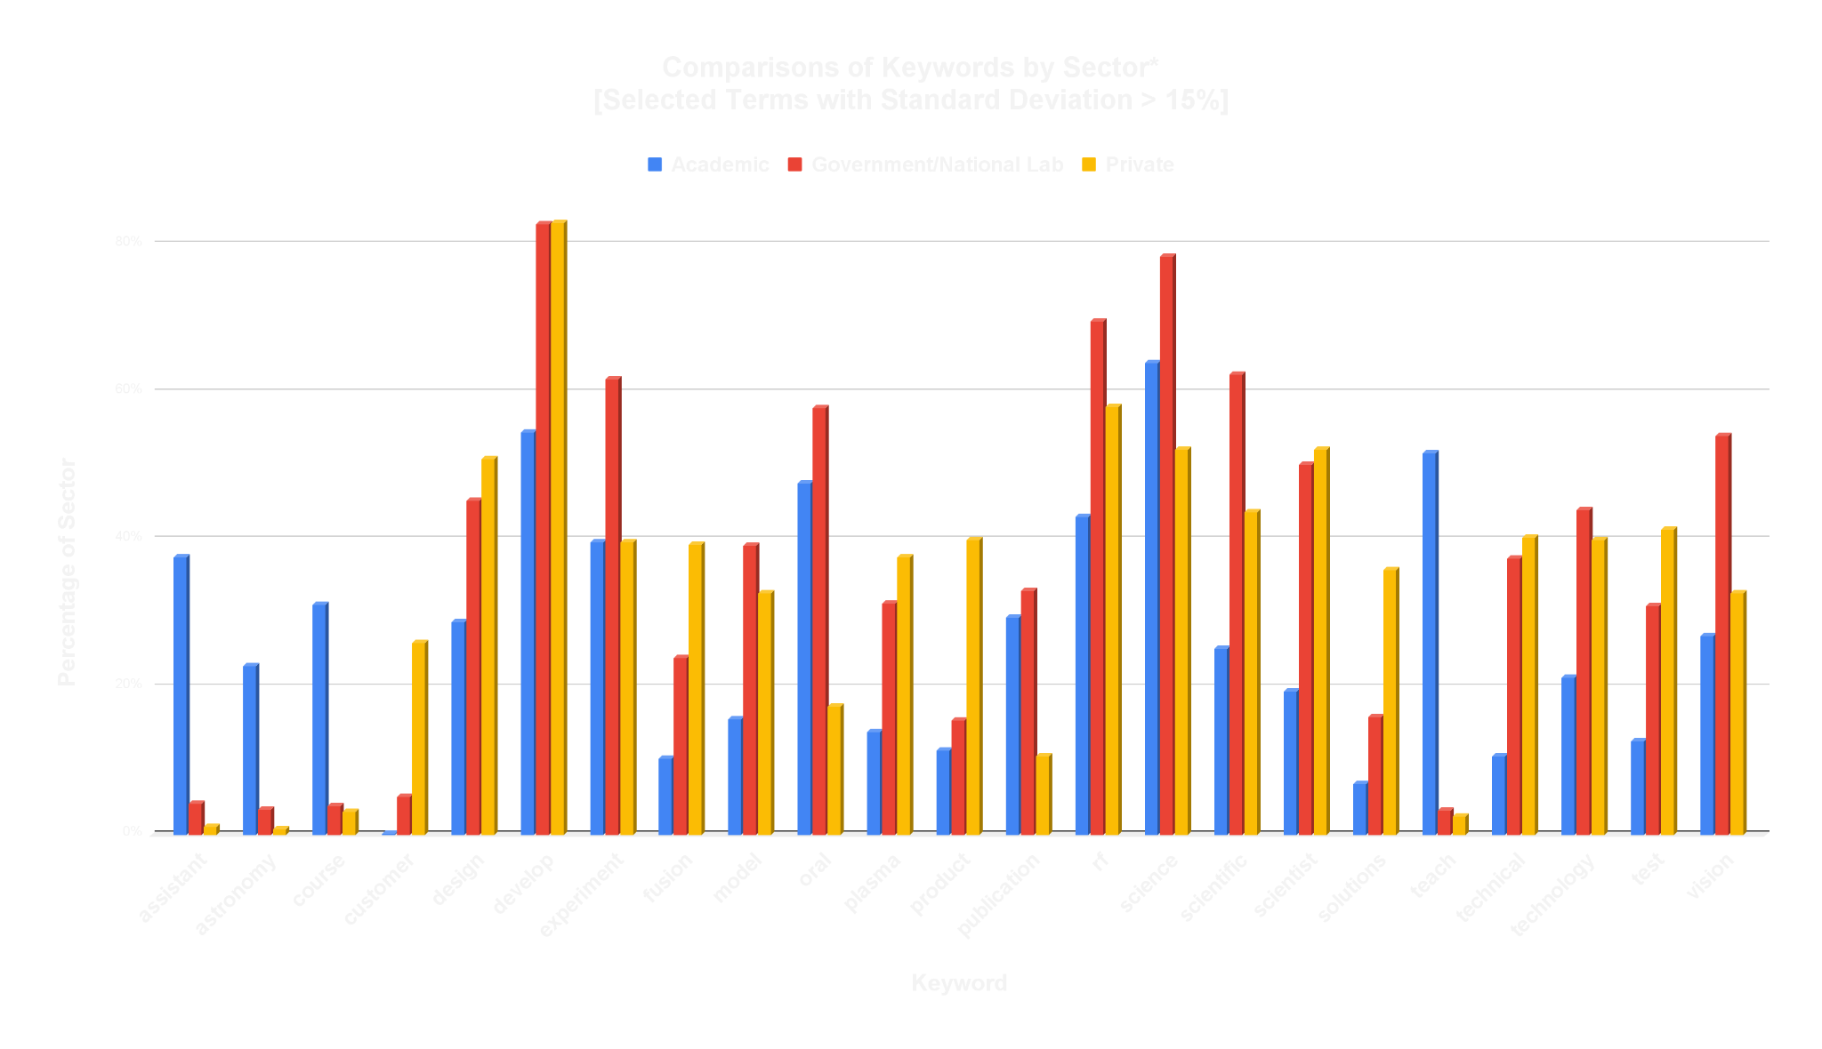
*this data does not show analyses for nonprofits and other sectors
9
Notes:
These graphics show the percentage of the sector that contains each keyword. For example, the first keyword, “assistant,” appears in about 40% of all academic jobs. The terms shown are selected from those with the highest variance between sectors. Blue represents academic, red is government and national lab, and yellow is private.
Some results seem obvious.
Keywords like “assistant”, “course”, and “teach” are much more common in academia, as one might expect.
"Customer” and “product” are more prevalent in the private sector, because they’re more market-oriented.
Terms like "Design,” “develop,” “model,” “solutions,” “technical,” “technology,” and “test” are more common in private and government sectors, because these positions are more R&D oriented, while academic jobs have a higher teaching component
"Vision” is most common in governments fields, because labs are often vision-driven and there is more strategic planning
Some results are more interesting:
Oddly, “oral” appears much more often in government and academia.
“Experiment” is equally prevalent in academia and private sectors, but it appears much more often in government and national labs.
“Fusion” and “plasma” appear more in government sectors, most likely due to the Princeton Plasma Physics Lab
Scientific appears more in govt, scientist appears almost equally in private and govt (likely because it is a position title), and science appears more in govt/academia, likely because basic science is not the goal of most companies

Slide 10
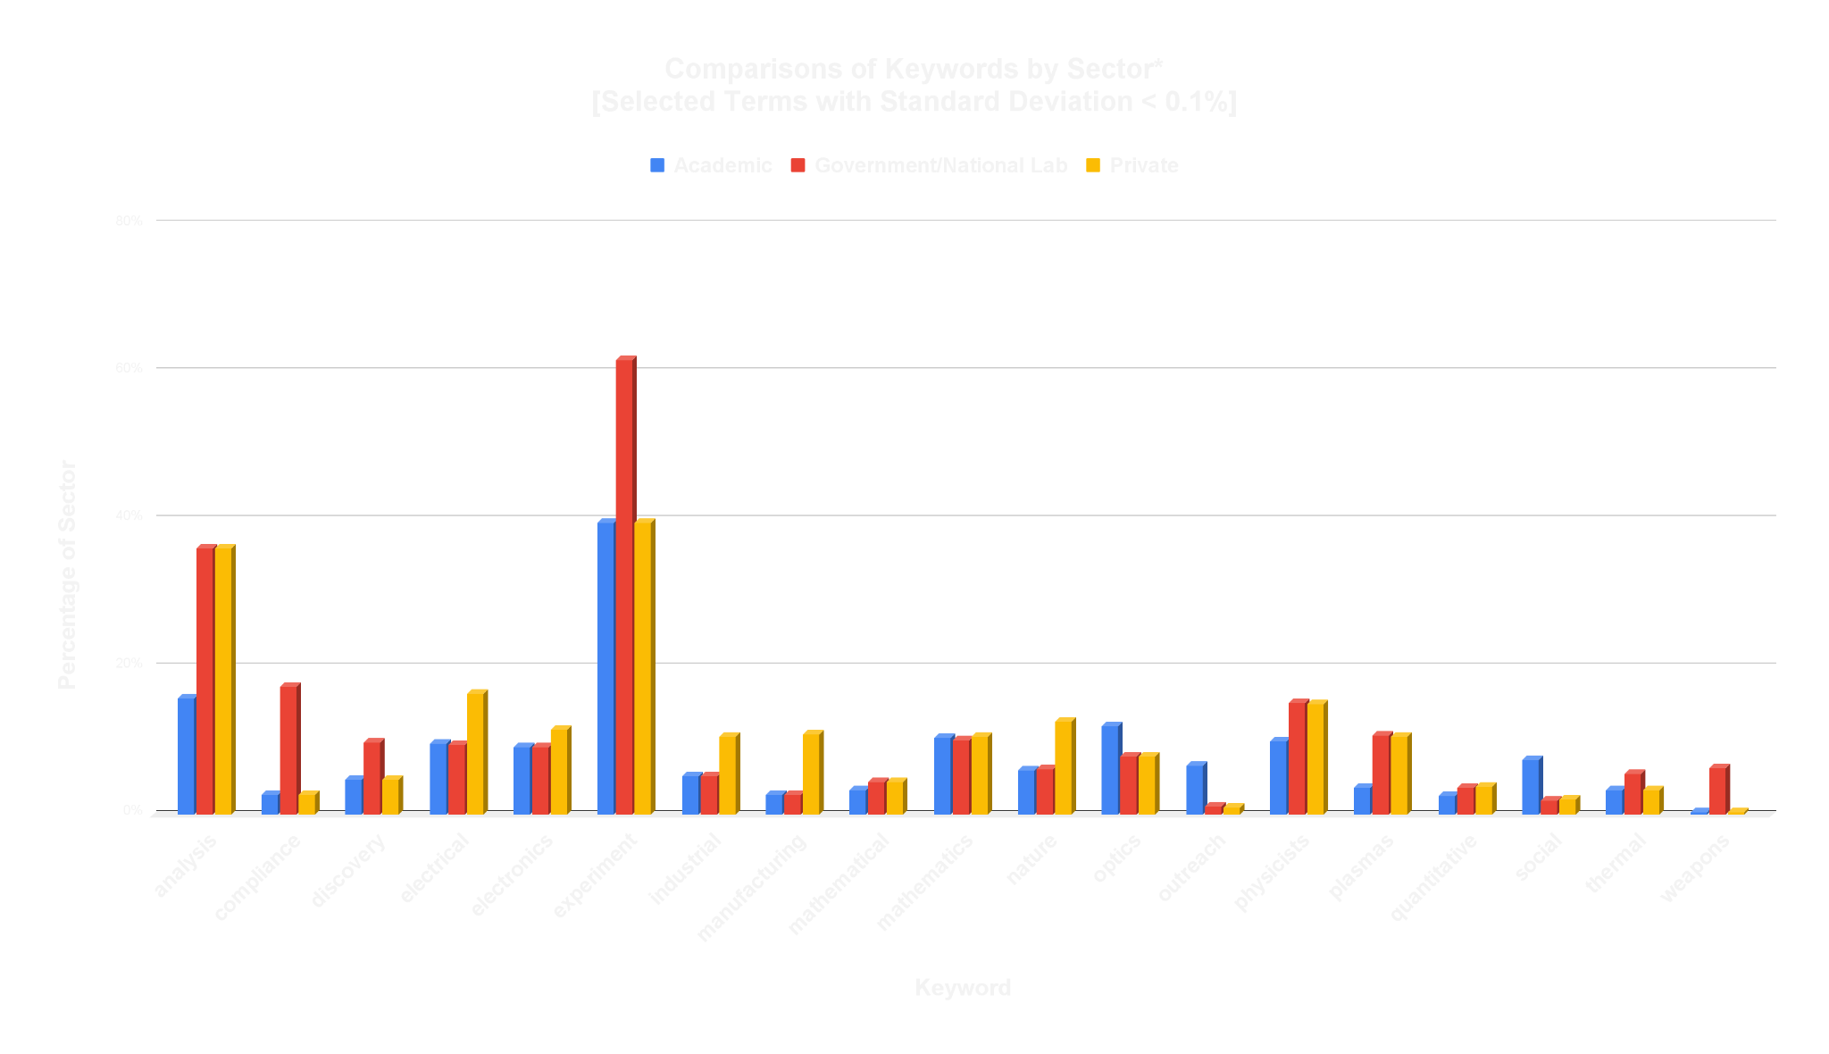
*this data does not show analyses for nonprofits and other sectors
10
Notes:
This chart compares keywords for selected terms with low variance between sectors.
Interestingly, “anaylsis” is much more common in government and private sectors than academic sectors.
“Compliance” appears more often in government sectors, as one might expect.
Unsurprisingly, “weapons” more prevalent in government fields.
There are small differences, but it is interesting that “electrical,” “electronics,” “mathematical,” “mathematics,” “optics,” and “quantitative” appear somewhat reliably in all sectors. They seem to good skills to “bet on”
"Physicists” is mentioned more in government and private sectors than academia.

Slide 11
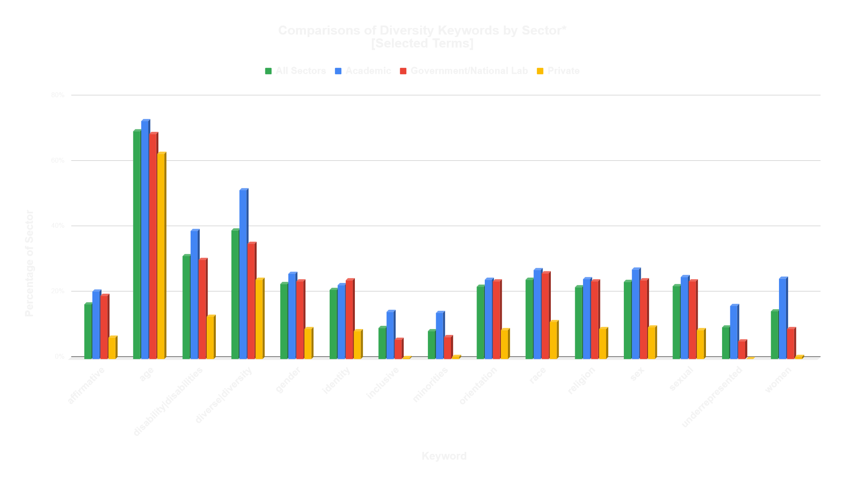
*this data does not show analyses for nonprofits and other sectors
11
Notes:
We also chose to investigate selected terms related to diversity based on sector.
A notable theme here is that private sectors have consistently lower mentions of diversity in their job descriptions.
Certain terms have a much greater disparity, such as “disability/disabilities,” “inclusive,” “minorities,” “underrepresented,” and “women”
We suspect that academic postings are consistently ahead due to the standard diversity language required by many universities—public sectors may be required to included diversity statements.

Slide 12
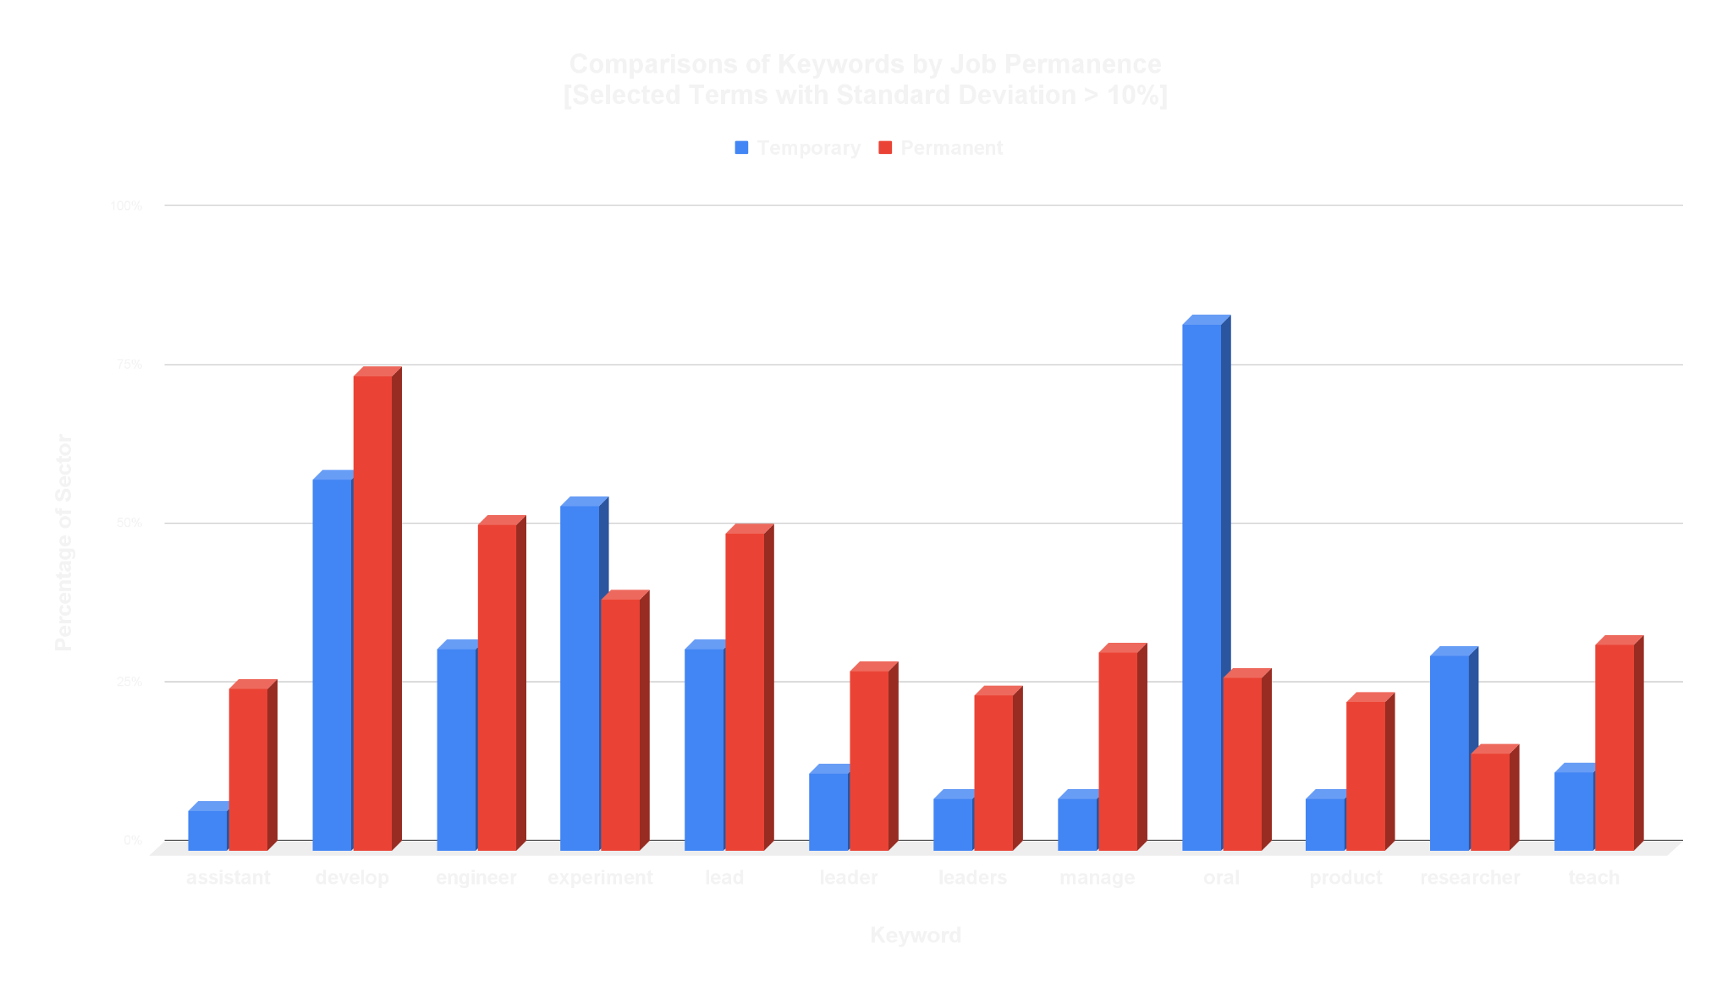
12
Notes:
We also found some interesting results based on job permanence:
Most permanent jobs involve development, leadership, management, and teaching
While temporary jobs focus more on experiment and research
Once again, we see an unexplained disparity with the term “oral”

Slide 13

Conclusions
Private sector jobs are much more likely to be permanent, but other sectors have more temporary jobs
Diversity terms by Job Permanence seem to be very similar [average STDEV is under 2%]
Keywords oriented towards research and development, such as "design, develop, model, technical" were more prominent in the private and government sectors, while terms like "teach" and "course“
"Experiment" appears most often in the government sector, and appears with similar regularity within academic and private jobs.
11
Notes:
Unlike our sector results, diversity terms seem to be about equal in temporary and permanent jobs
A high percentage of jobs in the private sector are permanent positions, while academia and government have large proportions of temporary positions.

Slide 14
Conclusions
Job Permanace
Government Terms
01
03
Sector Terms
Diversity
02
04
Private sectors have far fewer temporary jobs
Experiment appears more in government jobs, and about equally in other sectors
Academic and R&D terms appear as expected
Trends in diversity terms by sector vs job permanence
13
Notes:
To conclude,
A high percentage of jobs in the private sector are permanent positions, while academia and government have large proportions of temporary positions.
Keywords oriented towards research and development, such as "design, develop, model, technical" were more prominent in the private and government sectors, while terms like "teach" and "course“
"Experiment" appears most often in the government sector, and appears with similar regularity within academic and private jobs.
Diversity terms do not seem to change by job permeance. The average STDEV between temporary and permeant jobs is under 2%, compared to 9% between all sectors. As we saw, the private sector did not include near as many terms as other sectors.

Slide 15
Next Steps
Further Analyses
Development
Analyze job data based on degree requirements, job level, and/or location
Integrate pre-processing into the job data tool and add ability to intelligently identify imported columns.
14
Notes:
While our analysis provided sone interesting insights, we have more work we can perform to further this project.
If I had more time, I would perform further analysis based on other conditions, such as degree requirement and job level.
Our application has significant functionality, but we could still extend its scope by integrating pre-processing and improving the import module to intelligently identify imported columns.

Slide 16

Any Questions?
Many thanks to my project supervisor, Midhat Farooq, for her mentorship and support throughout this summer. Additionally, thanks to the amazing folks at SPS National and AIP for their work making our summer awesome!
Credits: This presentation template was created by Slidesgo, including icons by Flaticon, and infographics/images by Freepik.
15
Notes:
I’d like to give special thanks to my mentor, Midhat, for all her help and support throughout this project, and to all the folks at AIP that made the internship possible! I’ll now open to any questions.

